Slide 1
Propositional Equivalences
Course Code: CSC 1204
Course Title: Discrete Mathematics
Dept. of Computer Science
Faculty of Science and Technology
Lecturer No: | 3 | Week No: | 2 | Semester:
Lecturer: | Name & email

Slide 2
Lecture Outline
1.2 Propositional Equivalences
Tautology
Contradiction
Contingence
Logical Equivalences

Slide 3
Objectives and Outcomes
Objectives: To understand the terms Tautology, Contradiction, Contingence with examples, to understand the standard logical equivalences, to determine whether a compound proposition is a Tautology or Contradiction, to determine whether two compound propositions are logically equivalent.
Outcomes: Students are expected to be able to write the definitions of Tautology, Contradiction and Contingency with examples, be able to determine whether a compound proposition is a Tautology or Contradiction using a Truth Table and standard logical equivalences, be able to determine whether two compound propositions are logically equivalent using a Truth Table and logical equivalences.

Slide 4
Preface
An important type of step used in a mathematical argument is the replacement of a statement with another statement with the same truth value.

Slide 5
Tautology
Tautology: A compound proposition that is always true is called a tautology.
Examples:
a) p ∨ ¬p
b) The professor is either a woman or a man
c) People either like watching TV or they don’t

Slide 6
Contradiction
Contradiction: A compound proposition that is always false is called a contradiction.
Examples:
a) p ∧ ¬p
b) All men are good and all men are bad

Slide 7
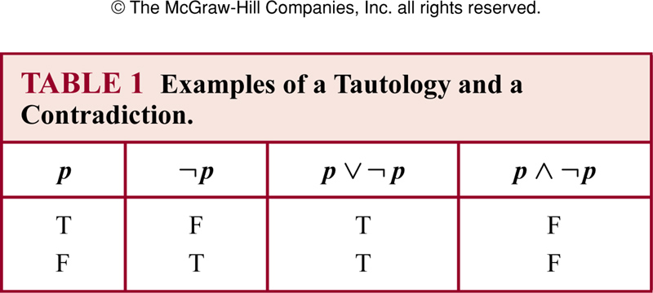
Examples of Tautology and Contradiction

Slide 8
Contingency
Contingency: A compound proposition that is neither a tautology nor a contradiction is called a contingency.
In other words, a compound proposition whose truth value is not constant is called a contingency.
Examples:
a) p → ¬p
b) p
c) ¬p

Slide 9
How to determine whether a compound proposition is a Tautology or Contradiction?
We can determine whether a compound proposition is a Tautology or contradiction it in two ways:
  Using a truth table – The easiest way to see if a compound proposition is a tautology or contradiction is to use a truth table. Show that the compound proposition is always true
  Using (laws of) Logical Equivalences

Slide 10
Tautology : Example
Show that [¬p ∧(p ∨q )]→q is a tautology using a
Truth Table

Slide 11
Solution
p | q | ¬p | p ∨q | ¬p ∧(p ∨q ) | [¬p ∧(p ∨q )]→q
T | T
T | F
F | T
F | F

Slide 12
Solution
p | q | ¬p | p ∨ q | ¬p ∧(p ∨q ) | [¬p ∧(p ∨q )]→q
T | T | F
T | F | F
F | T | T
F | F | T

Slide 13
Solution
p | q | ¬p | p ∨q | ¬p ∧(p ∨q ) | [¬p ∧(p ∨q )]→q
T | T | F | T
T | F | F | T
F | T | T | T
F | F | T | F

Slide 14
Solution
p | q | ¬p | p ∨q | ¬p ∧(p ∨q ) | [¬p ∧(p ∨q )]→q
T | T | F | T | F
T | F | F | T | F
F | T | T | T | T
F | F | T | F | F

Slide 15
Solution
p | q | ¬p | p ∨q | ¬p ∧(p ∨q ) | [¬p ∧(p ∨q )]→q
T | T | F | T | F | T
T | F | F | T | F | T
F | T | T | T | T | T
F | F | T | F | F | T
Since the truth table shows all the true values of compound proposition
[¬p ∧(p ∨q )]→q are true(T), so it is a tautology.

Slide 16
Class Work
Determine whether ¬ (p ∧ q) ∨ p is a tautology or contradiction.
Determine whether p ∧ (q ∧¬p) is a tautology or contradiction.

Slide 17
Logical Equivalences
Compound propositions that have the same truth values in all possible cases are called logically equivalent.
Definition : Compound propositions p and q are logically equivalent if p ↔ q is a tautology (denoted by p ≡ q or p ⇔ q )

Slide 18
How to determine whether two compound propositions are logically equivalent?
We can determine whether two compound propositions are logically equivalent in two ways:
  Using a Truth Table
  Using (laws of ) Logical Equivalences

Slide 19
Using a Truth Table to determine whether two compound propositions are logically equivalent
Two compound propositions are logically equivalent if they always have the same truth values in the corresponding rows.
Construct a truth table for the given two compound propositions [in one table]
If the true values of both of the compound propositions are different in one or more rows, then they are NOT logically equivalent.

Slide 20

Example 1
Show that p ↔ q is logically equivalent to (p → q) ∧ (q → p)
Since the truth values of both of the compound propositions are same in the corresponding rows, they are logically equivalent.

Slide 21
Class Work
Show that p ∨ (q ∧ r ) and (p ∨q ) ∧ (p ∨ r ) are logically equivalent

Slide 22
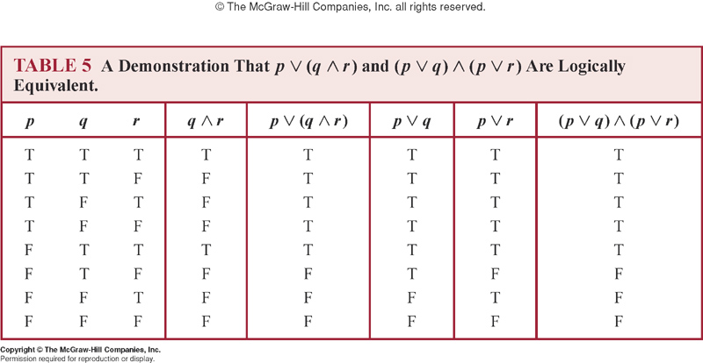
Solution
Since the truth values of both of the compound propositions are same in the corresponding rows, they are logically equivalent.

Slide 23
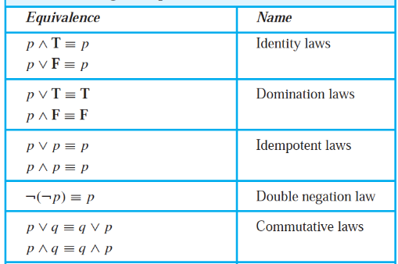
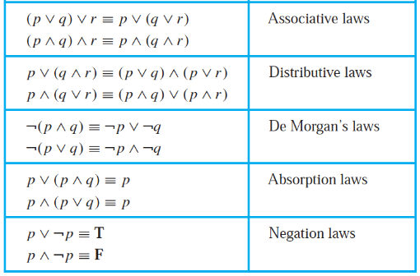
Logical Equivalences
Table 6 ( page 24 ) ➔ Rosen, 7th edition

Slide 24
A very Useful Logical Equivalence(ULE)
p → q ≡ ¬ p ∨ q

Slide 25
Example 1
Show that ¬(p → q) and p ∧ ¬ q are logically equivalent.
Solution:
by ULE

Slide 26
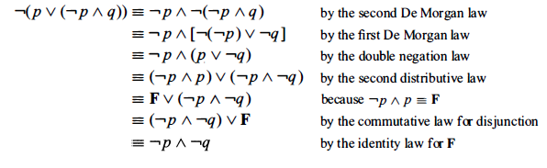
Example 7 (page 26)
Solution:

Slide 27
Exercise
Show that (¬p ∧(p ∨q ))→q is a tautology using a
series of logical equivalences.

Slide 28
Solution
(¬p ∧(p ∨q ))→q
≡ ( (¬p ∧p)∨(¬p ∧q) ) → q Distributive Law
≡ ( F ∨ (¬p ∧q))→q Negation Law
≡ (¬p ∧q )→q Identity Law
≡ ¬ (¬p ∧q ) ∨ q ULE
≡ (¬(¬p)∨ ¬q ) ∨ q De Morgan’s Law
≡ ( p ∨ ¬q ) ∨ q Double Negation Law
≡ p ∨ (¬q ∨q ) Associative Law
≡ p ∨ T Domination Law
≡ T So, (¬p ∧(p ∨q ))→q is a tautology.

Slide 29
Practice
Show that (¬q ∧ (p →q)) → ¬p is a tautology using a
series of logical equivalences.

Slide 30
Summary
What is Tautology and Contradiction? What is Contingency?
How to show/determine whether two compound propositions are logically equivalent?
    Using a truth table
    Using logical equivalences
How to show whether a compound proposition is a tautology?
    Using a truth table
    Using logical equivalences
Note: Make sure you learn the important Logical Equivalences in Table 6 (page 24) & ULE ( p → q ≡ ¬ p ∨ q )
Practice @ Home: Relevant Odd-numbered Exercises (e.g. 1, 3, 7, 9, 11, 15, 17 )

Slide 31
Books
Discrete Mathematics and its applications with combinatorics and graph theory (7th edition) by Kenneth H. Rosen [Indian Adaptation by KAMALA KRITHIVASAN], published by McGraw-Hill

Slide 32
References
Discrete Mathematics, Richard Johnsonbaugh, Pearson education, Inc.
Discrete Mathematical Structures, Bernard Kolman, Robert C. Busby, Sharon Ross, Prentice-Hall, Inc.
SCHAUM’S outlines Discrete Mathematics(2nd edition), by Seymour Lipschutz, Marc Lipson

